Slide 1
Mathematical Preliminaries
Introduction to Deep Learning
Module 1, Class 5
Topic: Adding Non-Linearities and Constructing a Simple Neural Network
Objective:
Students learn why linear models cannot represent nonlinear relationships, how element-wise nonlinearities (ReLU, tanh, GELU, etc.) overcome this limitation, and how forward / backward passes handle such activations within the backpropagation framework.

Slide 2
Pre-read
3Blue1Brown — “But what is a neural network?” (Deep Learning, Ch. 1). Short, visual intro to why you need nonlinear activations. Episode 1
Intro to Deep Learning: MIT: Good intro to gradient descent
Deep Learning for Computer Vision: Good intro to common activation functions
Khan Academy — Multivariable derivatives (unit) + chain rule. Handy refresher for backprop math.

Slide 3
Agenda
Recap: Two Linear Layers Collapse to One (Affine Equivalence)
Motivation for Non-Linearities
Adding a Non-Linearity: ReLU, tanh, etc.
Constructing a Two-Layer Network to Fit sin(x)
Stochastic Mini-Batch Gradient Descent
Backpropagation with Non-Linear Activations
Other Common Non-Linearities: Leaky ReLU, GELU, Swish, SwiGLU
Discussion + Homework

Slide 4
Constructing a Simple Neural Network..
y
u
A
B
f
x
L
In the previous lecture, we created a 2 layered network consisting of matrices A and B and a function f that maps the output of the second layer to a scalar L. We derived equations for derivatives of L against elements of matrices A and B. The matrix elements are also called weights
We then used these derivatives in a gradient descent loop to solve for the weights that drive the norm of u to zero..

Slide 5
Constructing a Simple Neural Network..
h
y_hat
W1
W2
f
x
L
b1
b2
y
Groundtruth
Hidden layer (because it sits between input and output, and hidden from view)
Have we constructed a neural network? Recall that a neural network should be able to non-linear problems. Let’s see if this network can learn to predict the value of a sin(x) for a given value of x. We’ll train the network on several [x, sin(x)] points, and use euclidean distance between network output and ground truth (sin(x)) as the loss..

Slide 6
Stochastic Minibatch Gradient Descent
In the gradient descent loop, it is common to consider a batch of points in practice, as the gradients for a single point can be quite noisy, resulting in optimization instability. Let’s denote the batch size by B. How do we pick B?
Say we have n data points
1<B<n
Select a subset of the dataset at every iteration (without replacement). Calculate gradient and update weights. Do until we sweep through the entire dataset
Best of both worlds. Stable gradients, lower compute
B=1
Select a random point from the dataset (without replacement)
Calculate gradient and update weights
Problem: Gradient is very noisy
B=n
Select the entire dataset at every iteration
Calculate gradient and update weights
Problem: Large matrices, compute heavy
n
Sample 1<B<n at each iteration. A sweep through the entire training dataset is called an epoch. Number of iterations in an epoch: n/B, assuming B divides n

Slide 7
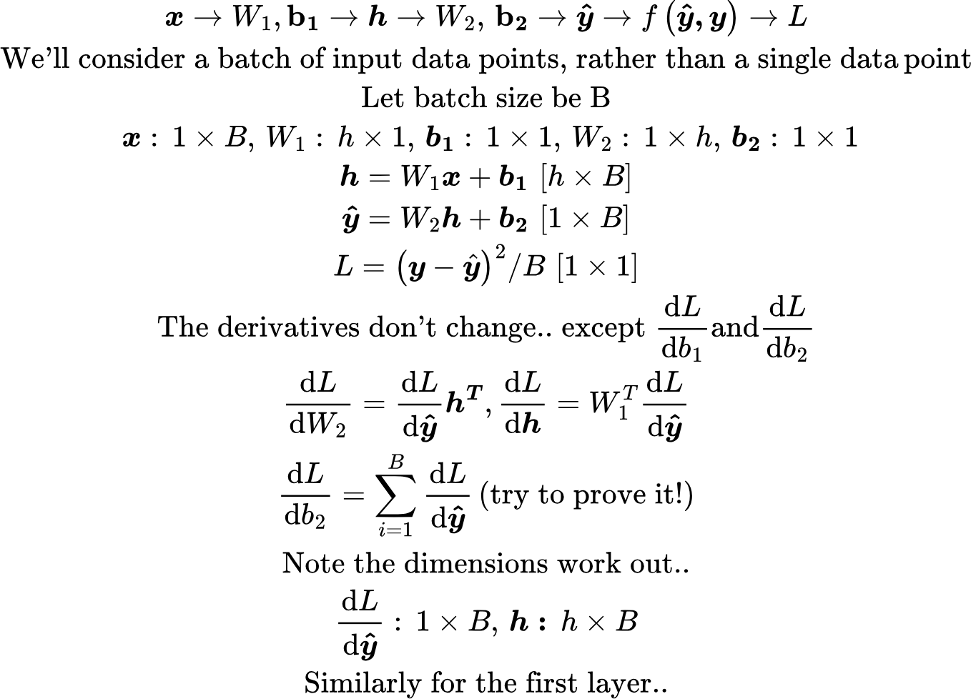
Constructing a Simple Neural Network..

Slide 8
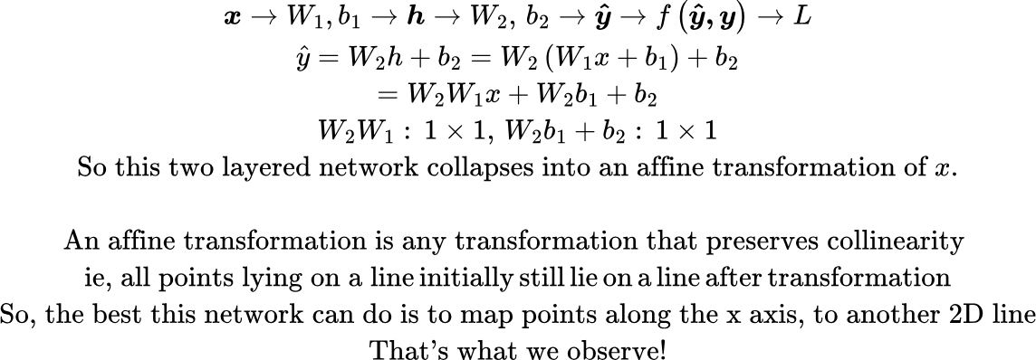
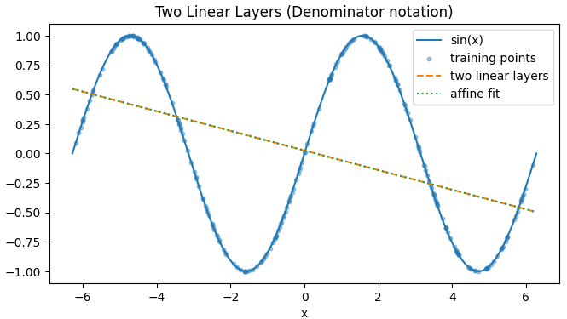
Constructing a Simple Neural Network..
Final value of Loss: 0.41
Code: two_linear_no_nonlinearity.py

Slide 9
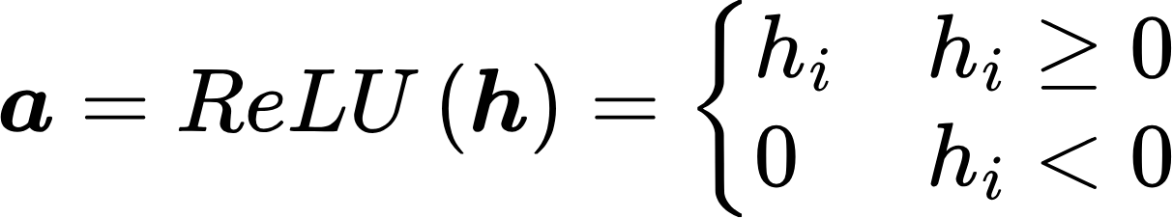
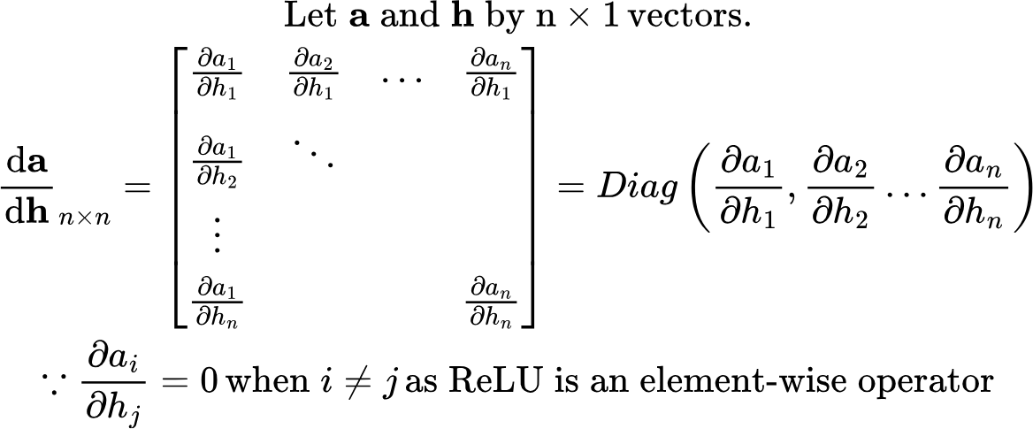
Let’s add a non-linearity: ReLu (Rectified Non-Linear Unit)
h
a
y_hat
W1
ReLU
W2
f
x
L
b1
b2
y
Groundtruth [Sin(x)]
Now I can no longer collapse the network into a single layer. The non-linearity also allows us to learn non-linear relationships.. As we’ll soon see
Note that ReLU (and non-linearities in general) are element-wise operators. They don’t have any parameters. All we need is the derivative of a against h. The rest of backpropagation remains unchanged

Slide 10
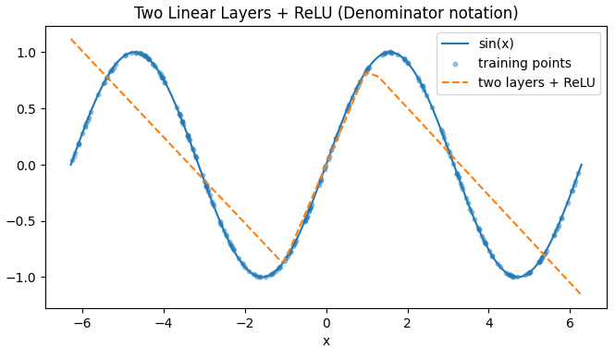
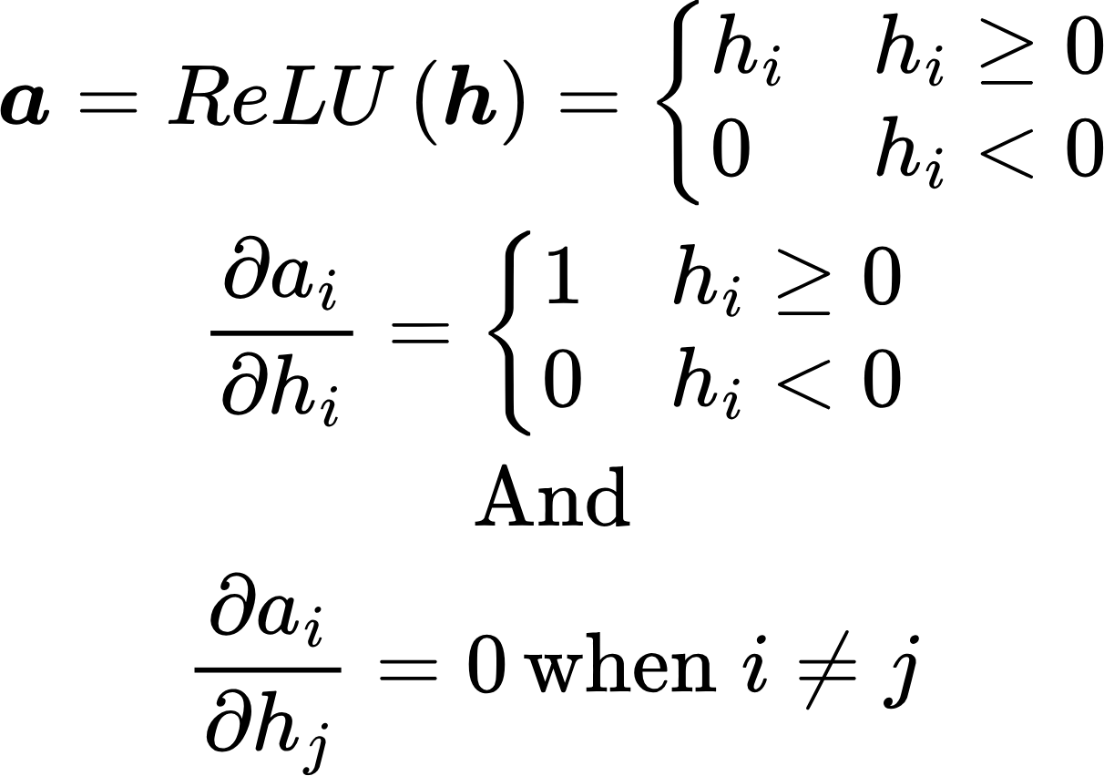
Let’s add a non-linearity: ReLu (Rectified Non-Linear Unit)
Final value of loss: 0.13.. Much better fit!
Code: two_linear_with_ReLU.py

Slide 11
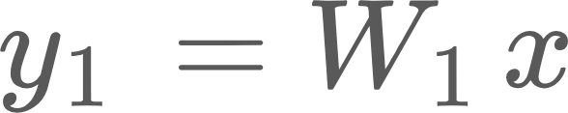


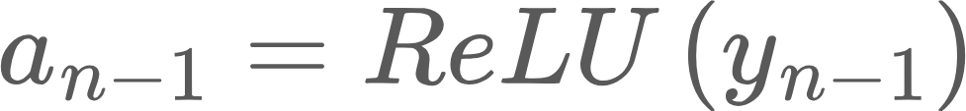
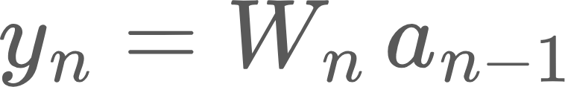




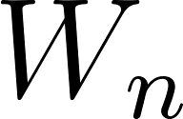



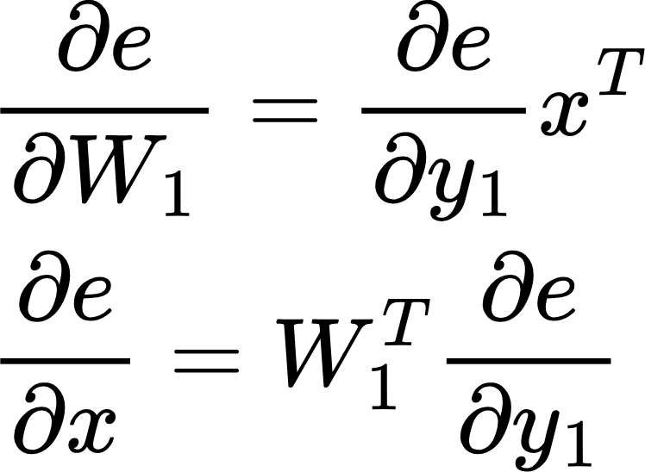
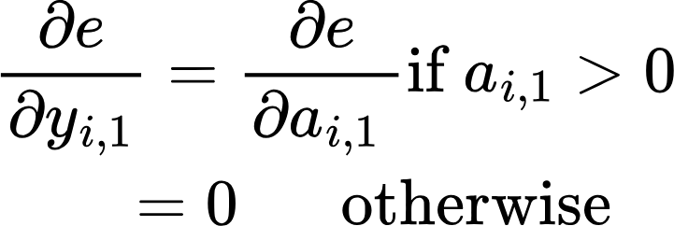
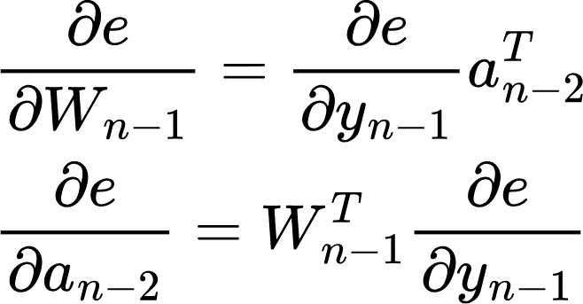
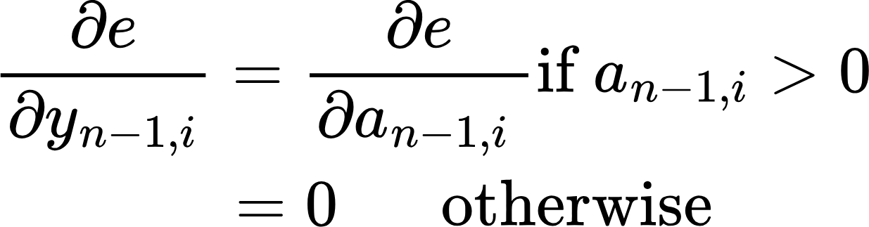
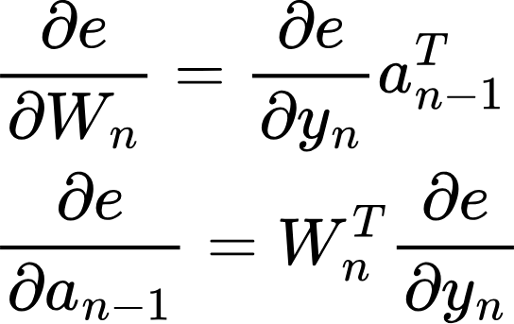
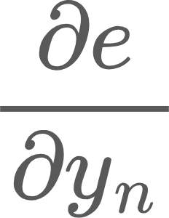
Backpropagation
Forward Pass or Inference
labels
ReLU
ReLU
Loss function (L)
…
Error
e = L(y)
Layer 1
Layer n-1
Layer n
Backward pass
(Training)
No parameters!
Notice we need the output of the previous layer in the backward pass!
Sent back to previous layers
Forward and Backward pass on a n layer network and using backpropagation to update weights
Used to update the weights of this layer

Slide 12
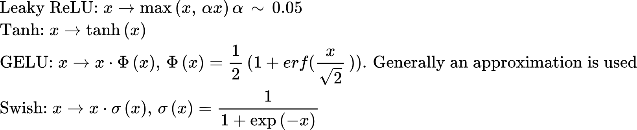
Other Non-Linearities
Lots of other non-linearities have been explored in literature, we’ll focus on some recent ones:
Leaky ReLU
Tanh
GELU (Gaussian Error Linear Unit)
Swish
SwiGLU (GELU + Swish: Latest in Transformers. Will discuss later)

Slide 13
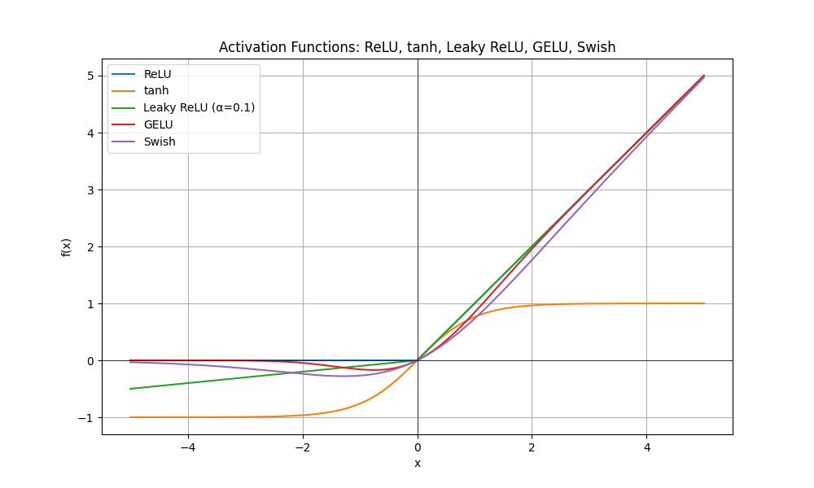
Other Non-Linearities
LeakyReLU: Allows a small, non-zero gradient when inputs are negative, keeping neurons alive and trainable
Tanh: zero-centered, smooth, but suffers from vanishing gradients
GELU: smoothest, probabilistic, dominates in modern Transformers.
See: non-linearities.py

Slide 14
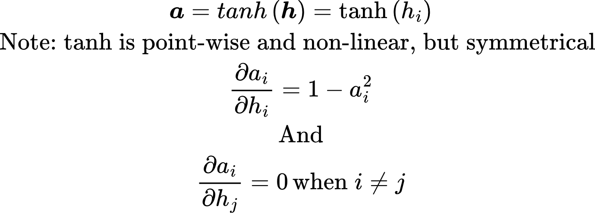
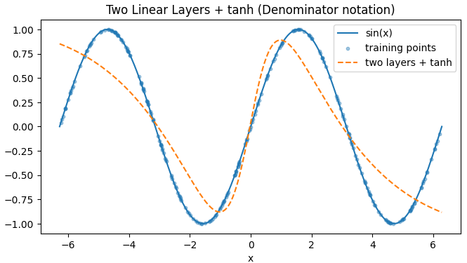
Different non-linearity: tanh
Final value of loss: 0.09.. Better fit than ReLU!

Slide 15
Homework problems
Modify two_linear_with_ReLU.py to replace ReLU with tanh non-linearity and verify the plot shown in slide 14
Experiment with different batch sizes B = 1, 8, 32 and observe how gradient noise affects training.

Slide 16
Supplementary Slides

Slide 17
Recall: Structure of a Network
Forward Pass or Inference
labels
ReLU
Loss function
Error
…
Backward pass or training
Points on a 2D space
Sequence of embeddings
Fourier transform coefficients of an audio sample
Images
Image patches
Video frames..
Key question: How do I adjust the weights to reduce error?
Answer: Backpropagation!

Slide 18
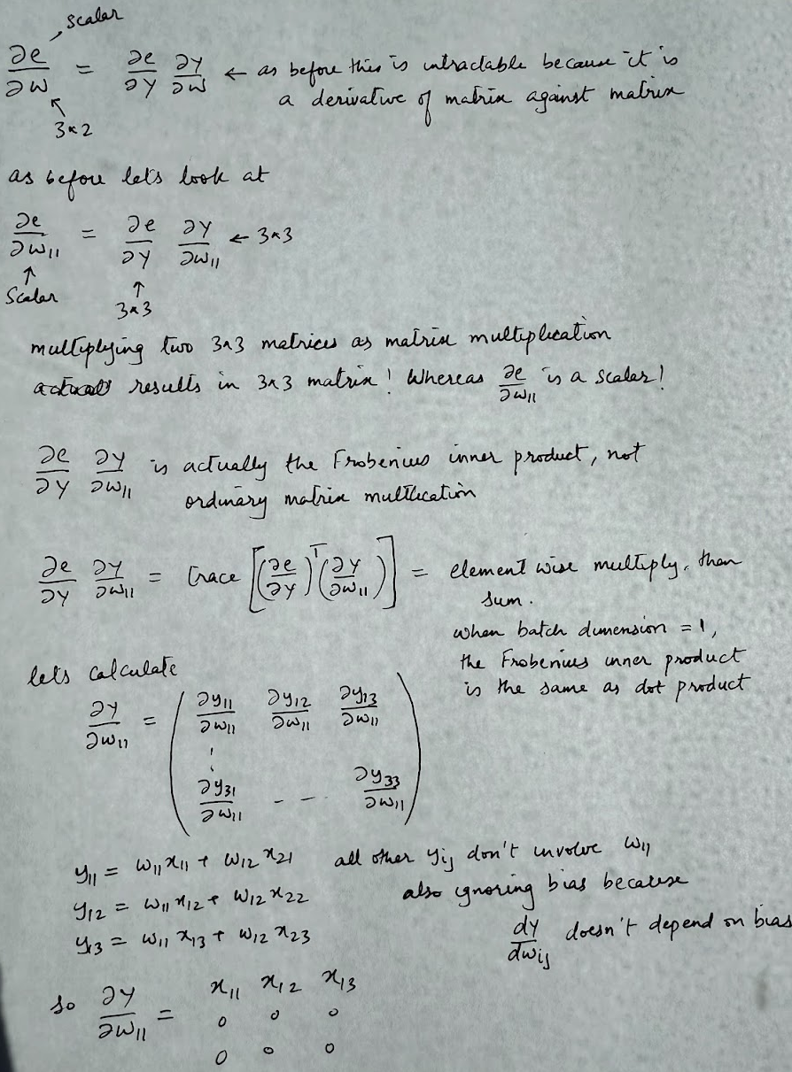
Backpropagation: Batched
Derivative of error against the weights

Slide 19
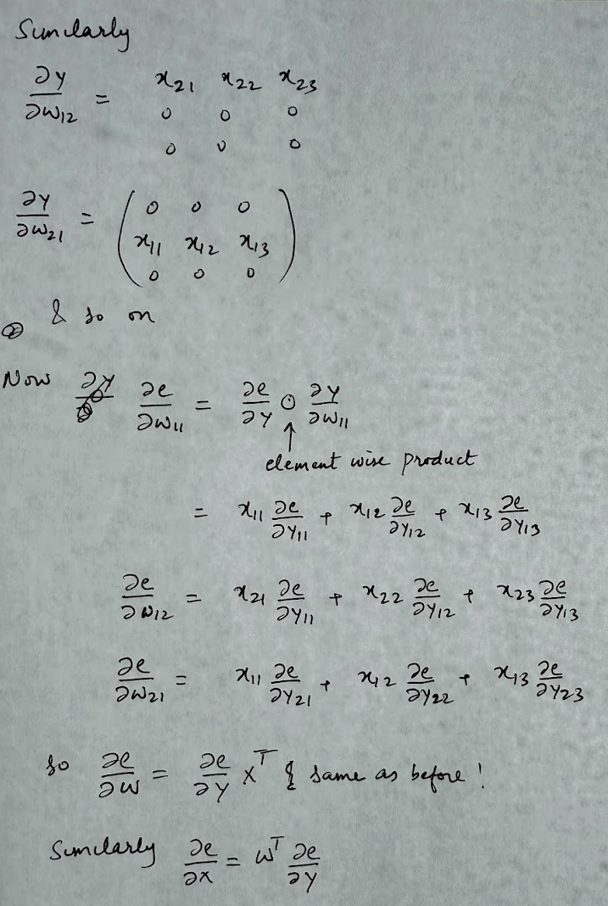
Backpropagation: Batched

Slide 20
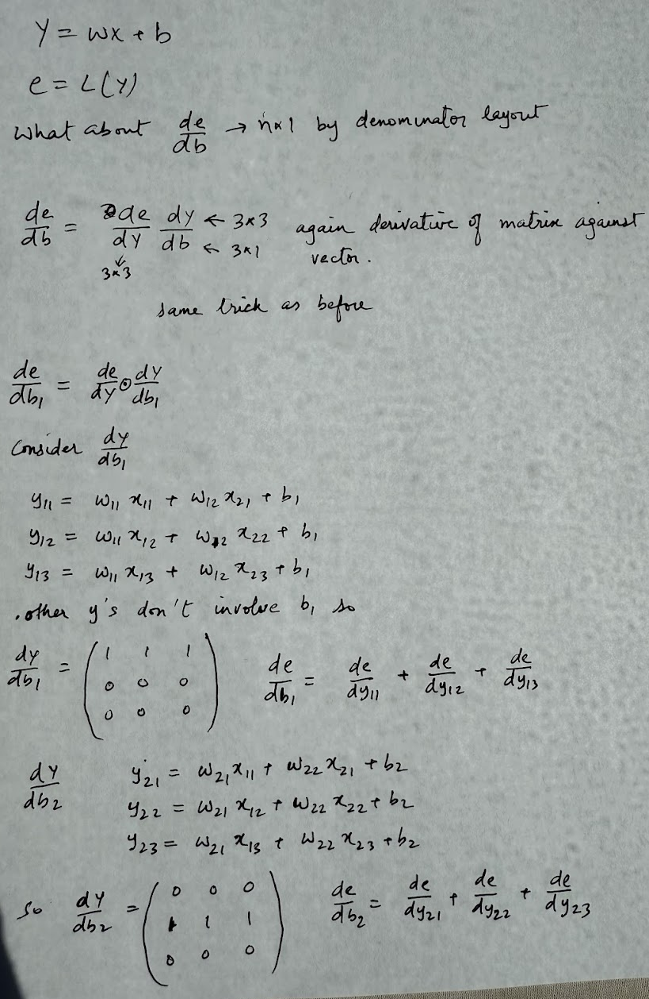
Backpropagation: Batched
Derivative of error against bias

Slide 21
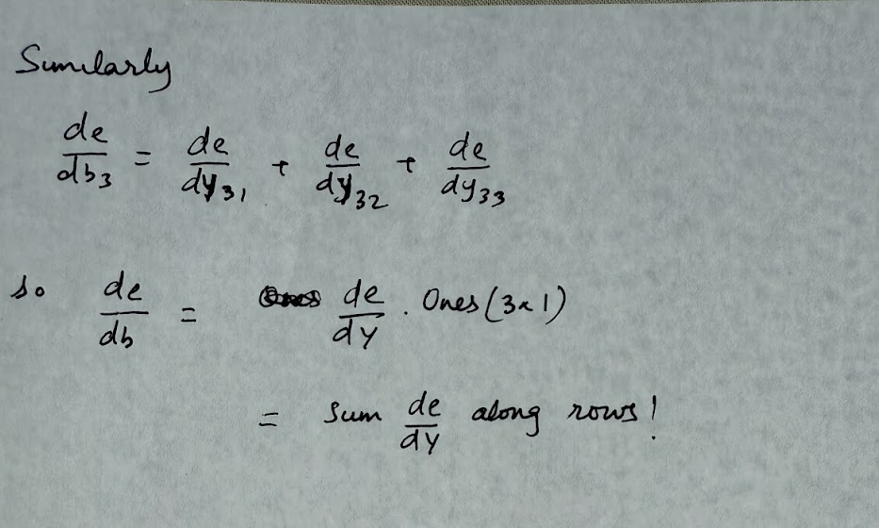
Backpropagation: Batched

